Slide 1


Rick Ayers
Deputy Manager/Emergency Manager
Emergency Alerts

Slide 2
Demographics
Population: 244,826
Households: 95K+

Slide 3
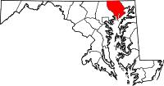
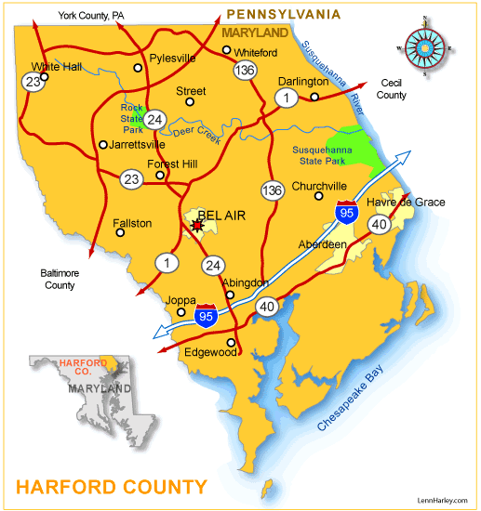
Geography
City of Aberdeen
City of Havre de Grace
Town of Bel Air
On the Chesapeake Bay
Notes:
Harford County straddles the border between the rolling hills of the Piedmont Plateau and the flatlands of the Atlantic Coastal Plain along the Chesapeake Bay and its tributaries. The county's development is a mix of rural and suburban, with denser development in the larger towns of Aberdeen and Bel Air and along Route 40 and other major arteries leading out of Baltimore. The highest elevations are in the north and northwest of the county, reaching 805 ft. near the Pennsylvania border in the county's northwestern corner. The lowest elevation is sea level along the Chesapeake Bay.

Slide 4
Why Harford County Chose Unlimited Use for Mass Notification

Slide 5
0
% of emergency managers that can predict the number of urgent events
Did you know?
65
% of communities who use their MNS for emergency reasons only
86
% of residents feel less connected when they only receive emergency communications
Notes:
Did you know?
0% of emergency managers can predict (move down, last grabber)
% smartphones/mobile devices
% landlines, etc.
% of population by age on facebook/twitter
% of revenue re: warrants
Rate of change of phone number/month

Slide 6
73
% of adult cell owners using the text messaging function
Mass Notification is Changing
41
Average # of text received per day by text messaging users
53
% of adult cell owners who prefer receiving calls to their cell phones
Notes:
New Communications Statistics
0% of emergency managers can predict (move down, last grabber)
% smartphones/mobile devices
% landlines, etc.
% of population by age on facebook/twitter
% of revenue re: warrants
Rate of change of phone number/month

Slide 7
Phone
  Landlines
  Mobile
E-Mail
SMS – Text Messaging
Facebook
Twitter
RSS
CAP
Alpha-pager
Web Portal
Multi-Modal Messaging

Slide 8
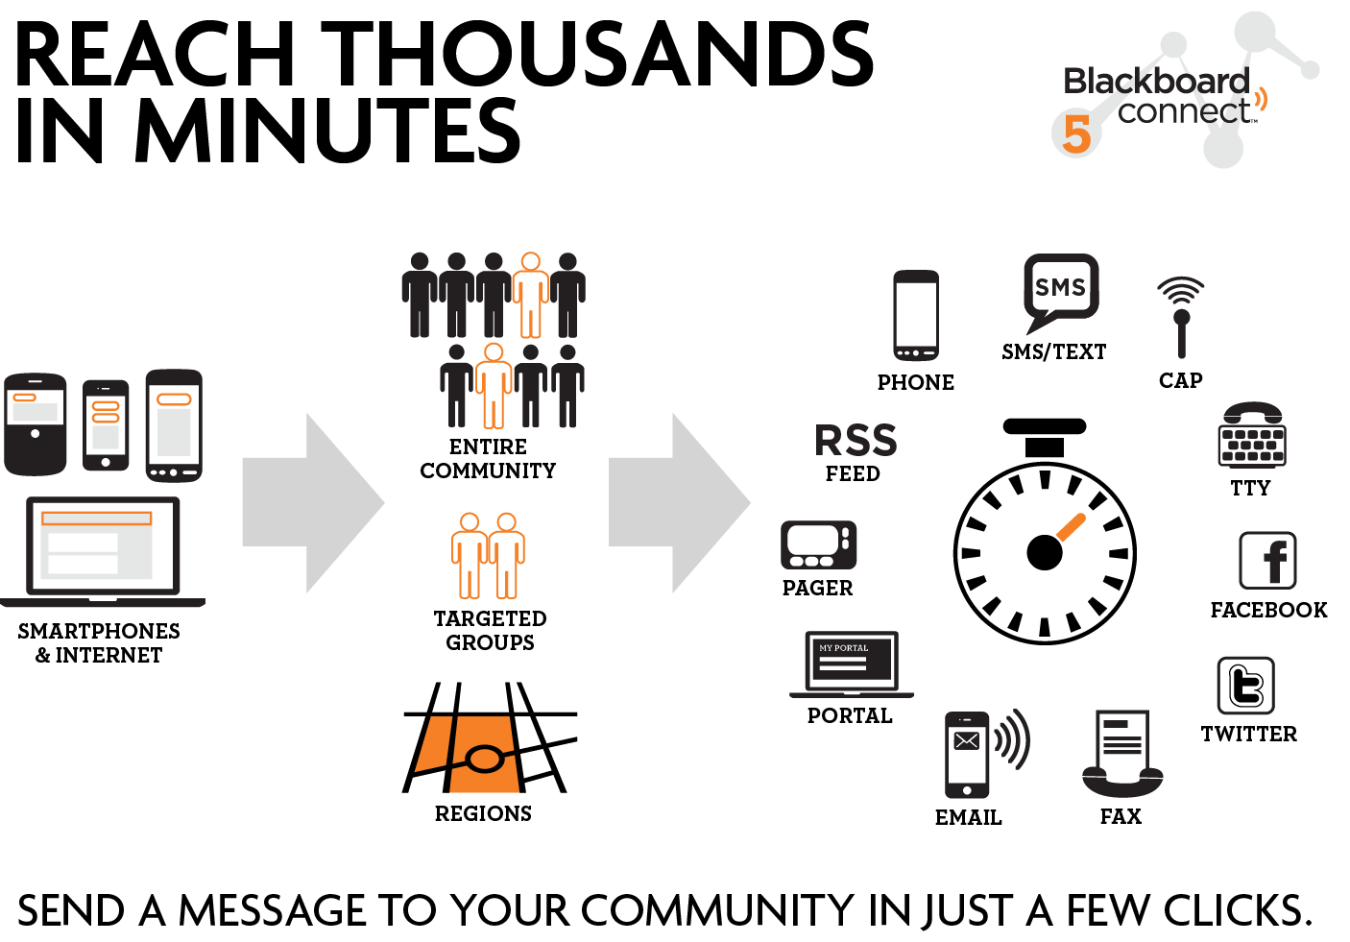

Slide 9
Hurricane Sandy

Slide 10
77 Calls Made
724,773 Recipients Contacted
783,642 Phone Messages
72,413 E-mails
12,201 Text Messages
??? Facebook Posts
??? Twitter Tweets

Slide 11
Daily Update Calls – Spike in Registration
October 26, 2012 96,280
October 27, 2012 99,479
October 28, 2012 100,216
October 29, 2012 100,743
October 30, 2012 100,968

Slide 13
Types of Messages
Weather Warnings
  Tornado Warnings
  Flood Warnings
  Hurricane Force Wind Warnings
Evacuations
Marina Updates
Public Updates
Employee Notifications
Public Official Notifications
Clean up Information
Health Department Drills
EOC Activation

Slide 14
Client Care
Fast and easy implementations within 30 days
Proactive client care
Help when you need it, 24 x 7 x 365
Dedicated Account Manager
Best practices coaching and crafting coupled professional
PR support by Edelman Worldwide

Slide 15
YouTube Videos
Harford County and Blackboard Connect 5
Blackboard Connect - Winter Weather
Upgrading to Blackboard Connect 5 - Harford County, MD
Upgrading to Blackboard Connect 5 - Harford County, MD
Emergency Communications - Extreme Winter Weather

