Slide 1
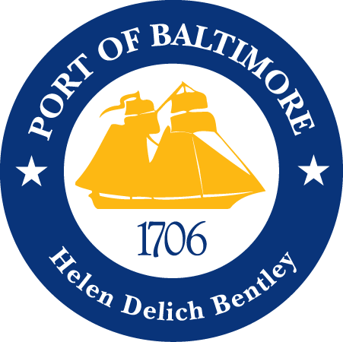
The Wealth in Our Water:
Port of Baltimore
Maryland Association of Counties Summer Conference
August 16, 2018
Dominic Scurti, MDOT Maryland Port Administration

Slide 2
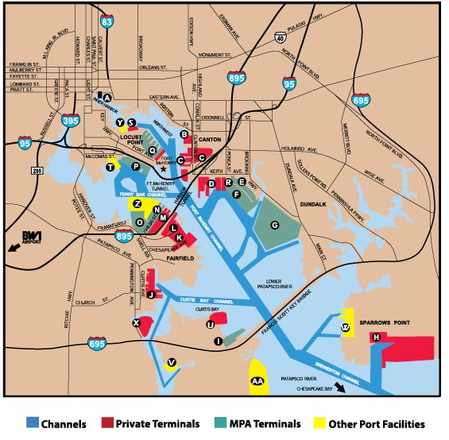
Port of Baltimore
Mix of private and state owned public terminals
9th largest port in the nation for international cargo value ($51B)
12th largest port for international tons (38.4 million)

Slide 3
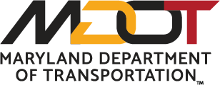
Maryland Port Administration
Established originally in 1956 as the Maryland Port Authority until 1971 when it was placed under Maryland Department of Transportation (MDOT).
Clear purpose: To increase the flow of waterborne commerce through the ports in the State of Maryland in a manner that provides benefit to the citizens of the State.
  Maintain and improve facilities
  MDOT MPA is the local sponsor for the U.S. Army Corps of Engineers projects
  Promote and market the Port of Baltimore

Slide 4
Economic Impact / Benefit to Maryland
13,650 Direct Jobs in Maryland
  Baltimore City 4,000 jobs
  Baltimore County 2,930 jobs
  Anne Arundel 2,480 jobs
  Harford 800 jobs
  Howard 200 jobs
  other 3,230 jobs
20,270 Indirect and Induced Jobs
93,700 Related Jobs
$2.9 Billion in personal wages
Average annual salary: $61,877
  16% higher than average Maryland annual wage
$2.2 Billion in business revenues
$310 million in state and local tax revenues
Based on 2014 data

Slide 5
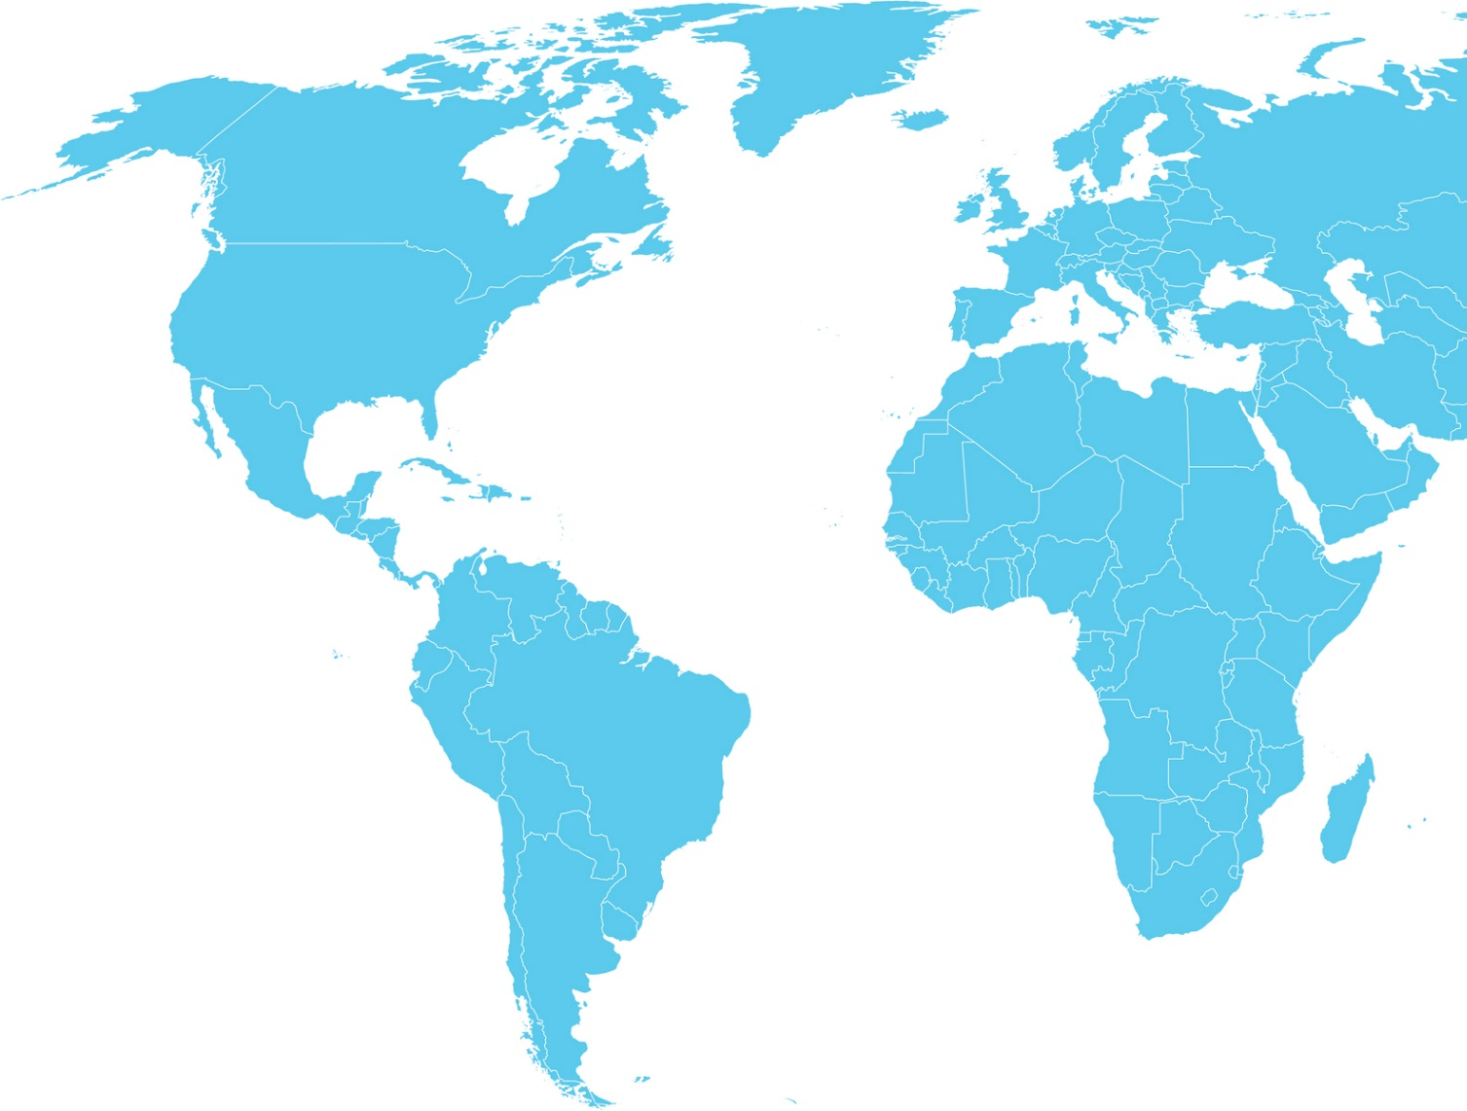
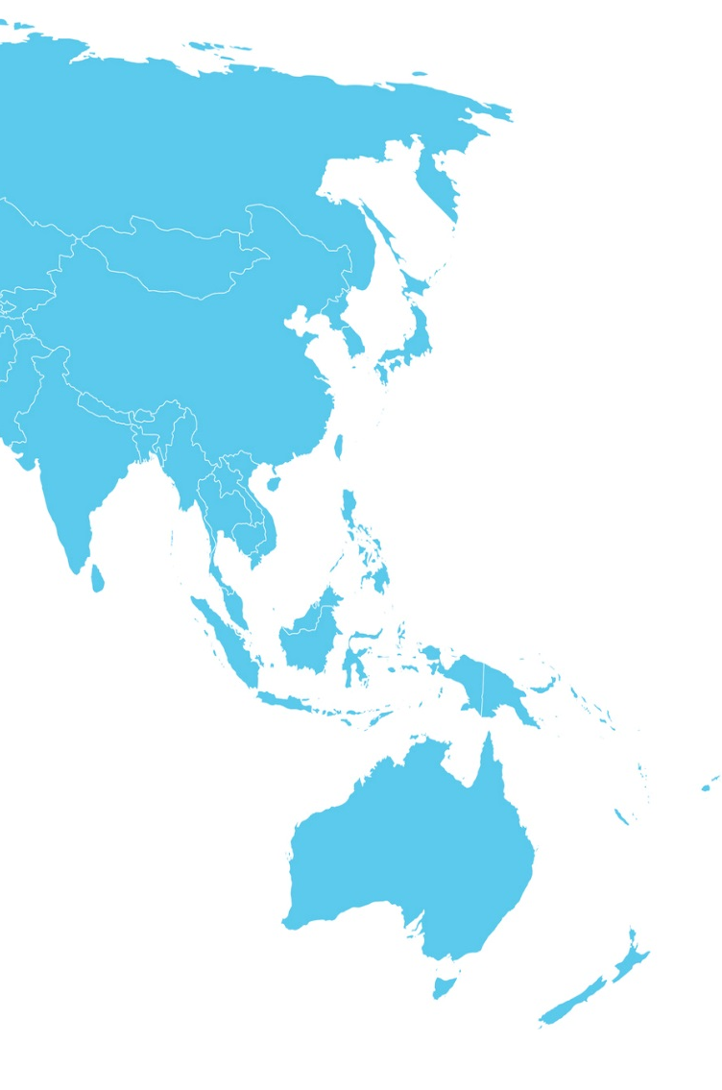

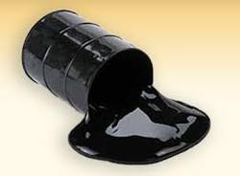
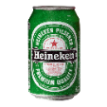

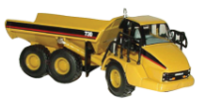
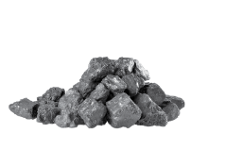

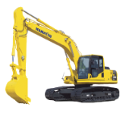




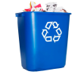
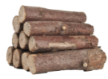

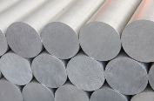





Port of Baltimore Imports & Exports
Bitumen
Coal
Coal
Salt

Slide 6
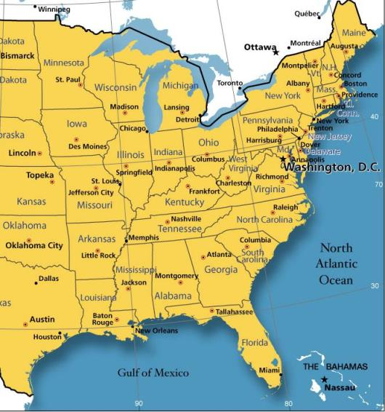




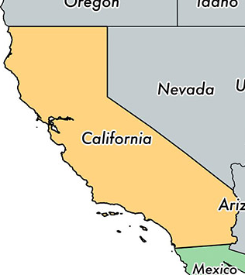



Manufacturers Exporting through the POB
Ford
Fiat Chrysler
General Motors
Tesla
Toyota
Honda
Caterpillar
John Deere
CNH
The Port of Baltimore is the largest port in the USA for the handling of automobiles and roll-on/roll-off (Ro/Ro) equipment.

Slide 7
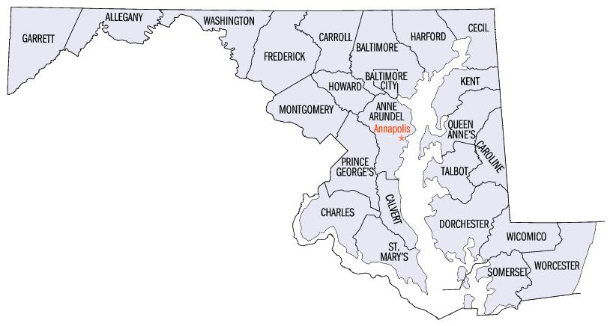
Companies in Maryland using the POB
Dal-Tile
Knorr Brake
Penguin Random House
Snavely Forest Products
Ikea
Michelin
Restoration Hardware
Ritchie Bros.
Total Biz Fulfillment
Aldi
Bramati Marble & Granite
Costco
Clark Associates
D S Livestock Equipment
Global Wholesale Supply
Paul Reed Smith Guitars
Stertil Koni
Albert Uster Imports
Architectural Ceramics
Nutricia North America
Bowman Logistics
Rayloc / Genuine Auto Parts
Staples
Tractor Supply
Volvo Powertrain
Maryland Plastics
Huntsman International
MY-A & Company
Regency Furniture
Kangde Xin America
Mid-Atlantic Pottery
Protenergy Natural Foods
Perdue
Sunspecs of Ocean City

Slide 8
MPA / POB Annual Cargo Tons
MPA General Cargo

Slide 9
Cruise Maryland
An estimated $1 million in economic activity is associated with each home port cruise call.

Slide 10
Investments in the Port of Baltimore
MDOT MPA Capital Transportation Program – $800m over next 6 years
Ports America Chesapeake / P3 at Seagirt:
  Completed the construction of berth four at 50 feet depth.
  Plans to deepen Berth #3 to 50 feet of depth within next two years.
TradePoint Atlantic:
  $50 million project to rehabilitate existing wharfs with a $20 million TIGER grant.
  Purchased Sparrows Point Shipyard in May 2018
Dominion Energy invested approximately $3.5 billion in their Cove Point LNG facility.

Slide 11
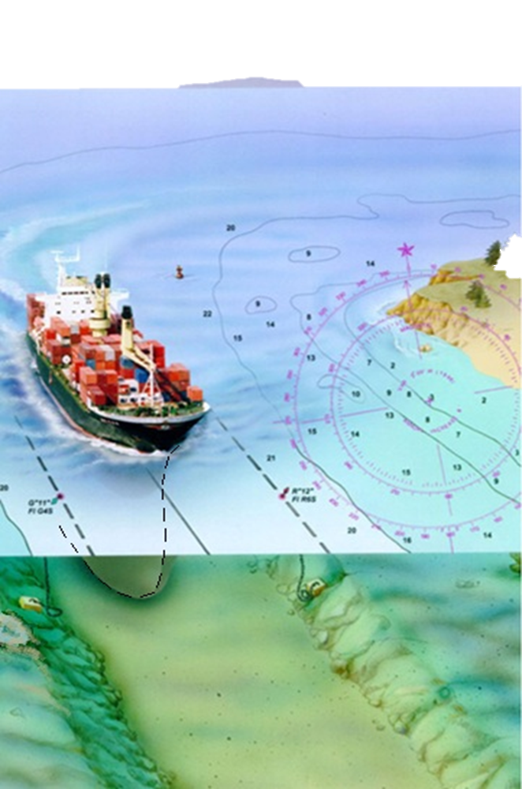
Dredged Material Management Program
Maintenance of our “marine highway” is critical to the economic health of the State
Requires sufficient dredged placement capacity
  4.7 Mcy annually
  20 year demand: 94.5 Mcy
Citizen and other stakeholder engagement is the key to implementing plans

Slide 12
Innovative Reuse and Beneficial Use
Innovative Reuse includes the use of “dredged material in the development or manufacturing of commercial, industrial, horticultural, agricultural or other products”
  Goal to use 500,000 cubic yards annually of dredged material
  Alternative Daily Cover at a Baltimore City landfill
  Engineered fill & light weight aggregate
Beneficial Use includes
  Restoration of underwater grasses and islands
  Creation or restoration of wetlands
  Creation, restoration or enhancement of fish/shellfish habitat

Slide 13
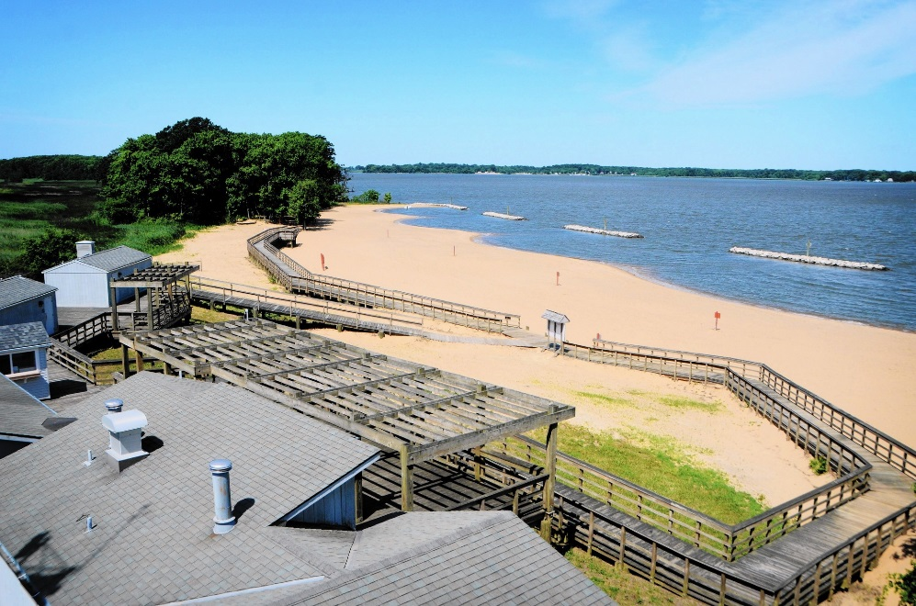
Dredged Material Containment Facilities
Three Baltimore Harbor Sites
  Hart-Miller Island
    1,100 acre facility that no longer accepts new dredged material
    South Cell is now a park open to the public (DNR)
  Cox Creek
    133 acre site
    Recognized as a great site for bird watching
  Masonville
    141 acres
    1st Urban Wildlife Refuge Center in USA

Slide 14
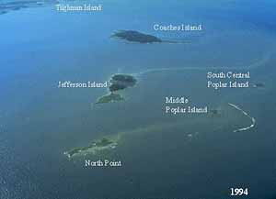
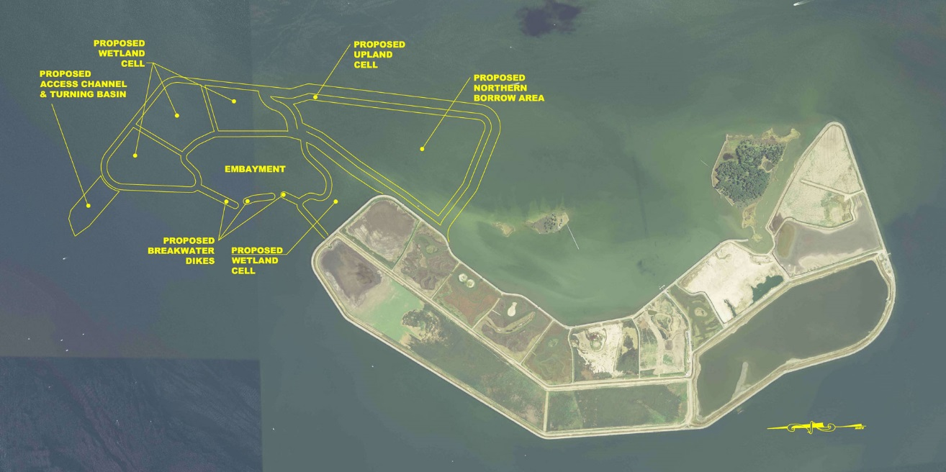
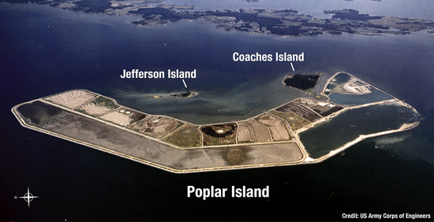
Poplar Island
Currently 1,140 acres
Expansion to add 575 additional acres
National model for habitat construction

Slide 15
In Summary
The Port of Baltimore delivers well paying jobs across many sectors.
Private companies are making investments in Maryland because of the Port.
The cheapest form of transportation is by water. The closer goods can travel by water to their destination, the cheaper the costs.
We are using dredged material in beneficial ways to the environment and looking at innovative ways to reuse the material in commercial applications.

